Slide 1


Multiplatform App Mobile Dev Course FLUTTER with FIRESTORE
bit.ly/flutterkerul
(for slides & notes)

Slide 2




T13 Online database (serverless)
Youtube tutorials
bit.ly/kerulflutter

Slide 3

Github.com/khirulnizam/makanapps wasap.my/60129034614
Youtube channel
bit.ly/kerulflutter

Slide 4

Serverless option using Firebase
Serverless computing is a method of providing backend services on an as-used basis
A Serverless provider allows users to write and deploy code without the hassle of worrying about the underlying infrastructure
Scalable - the serverless vendor handles all of the scaling on demand
Simplified backend code
Quicker turnaround

Slide 5

JSON Concept
JSON: JavaScript Object Notation.
JSON is a lightweight data-interchange format
JSON format is text only, it can easily be sent to and from a server.

Slide 6
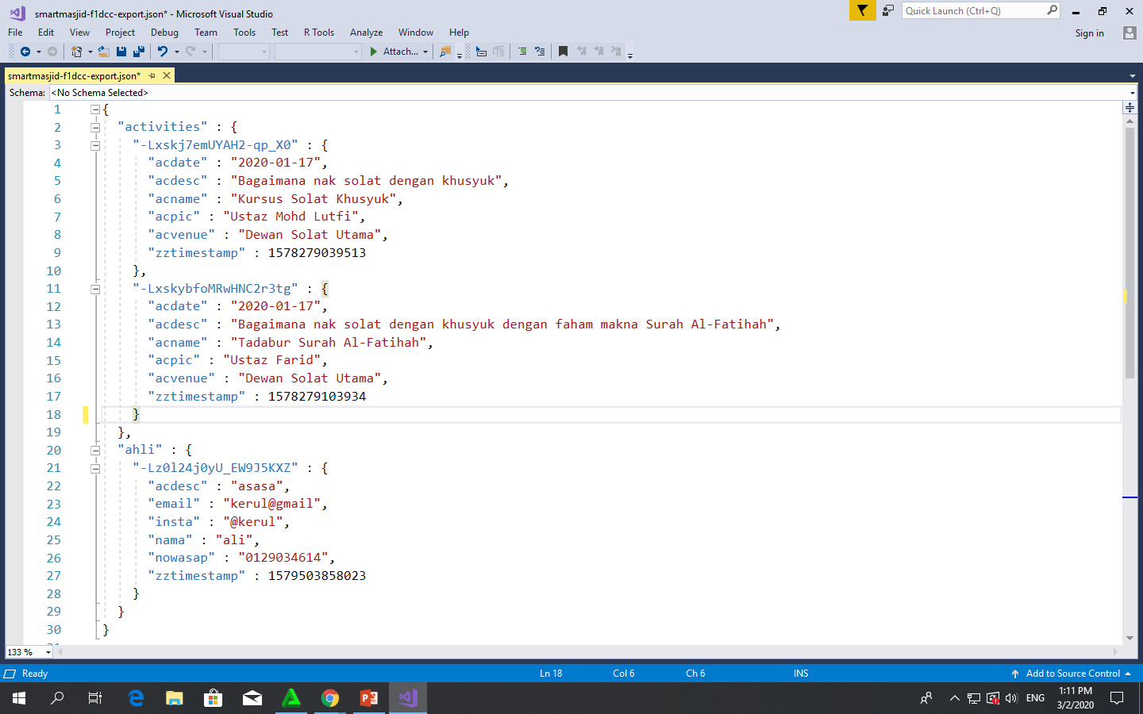
Play.google.com
JSON format example as applied in Firebase

Slide 7
OVERVIEW TO FLUTTER CRUD PROJECT

Slide 8
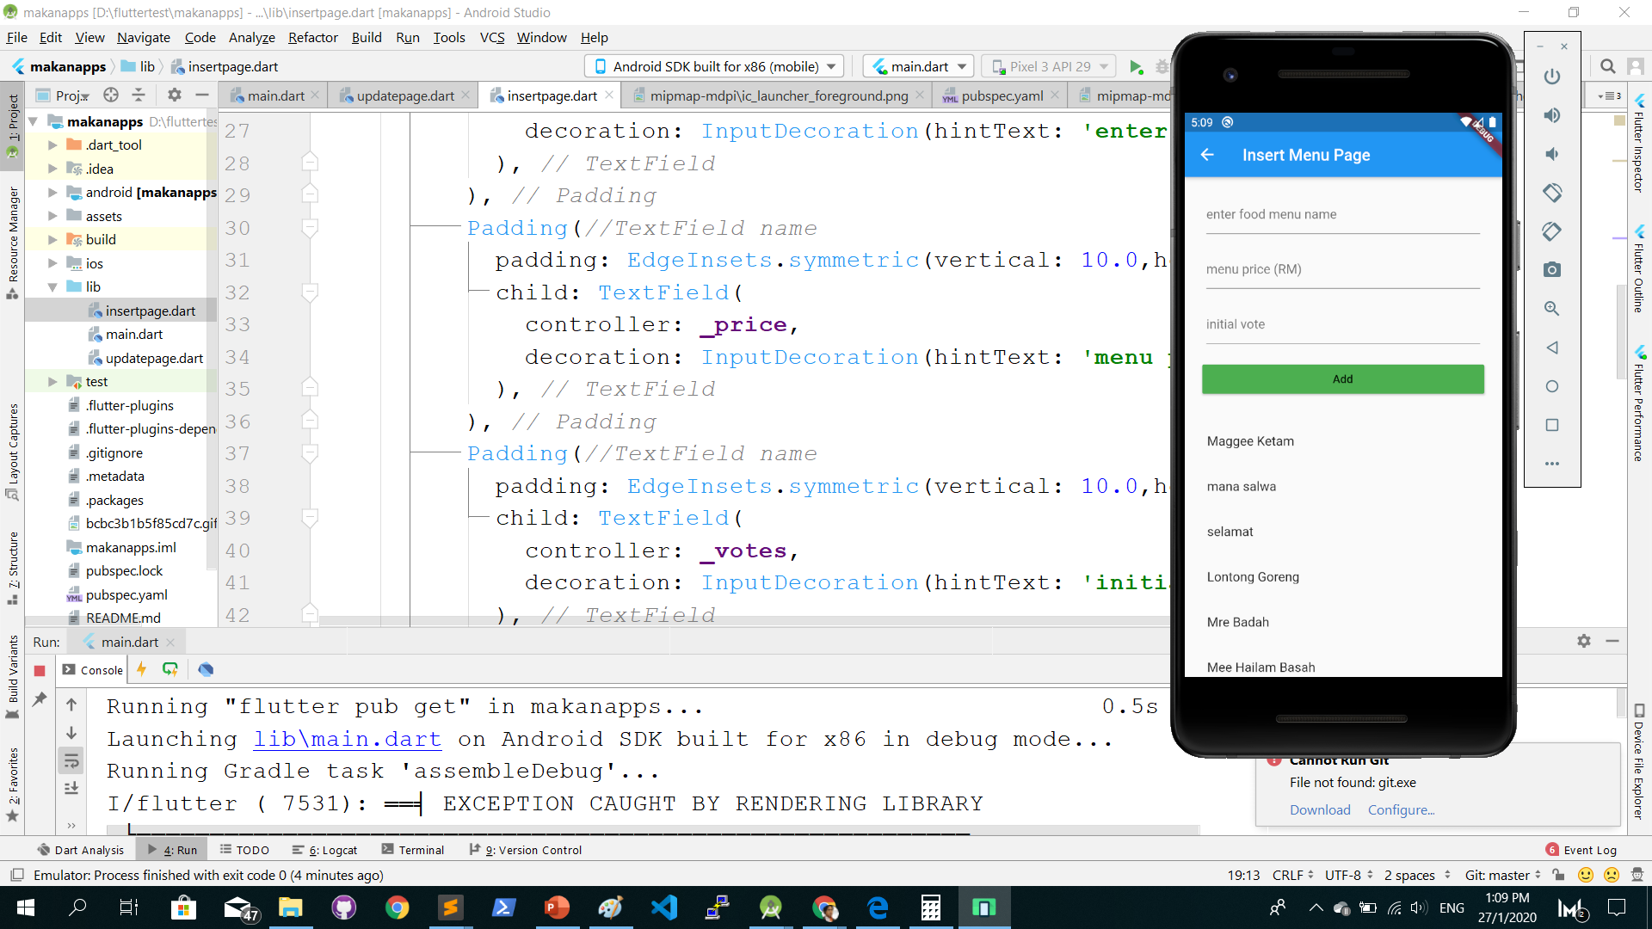
Push a new record from TextField

Slide 9
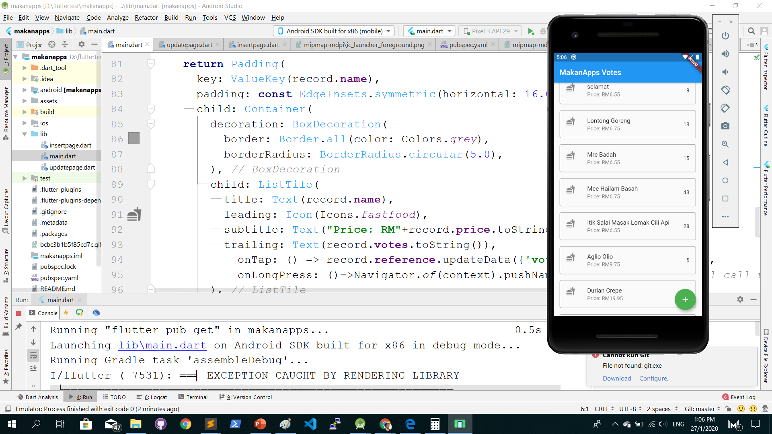
Populate records to ListTile

Slide 10
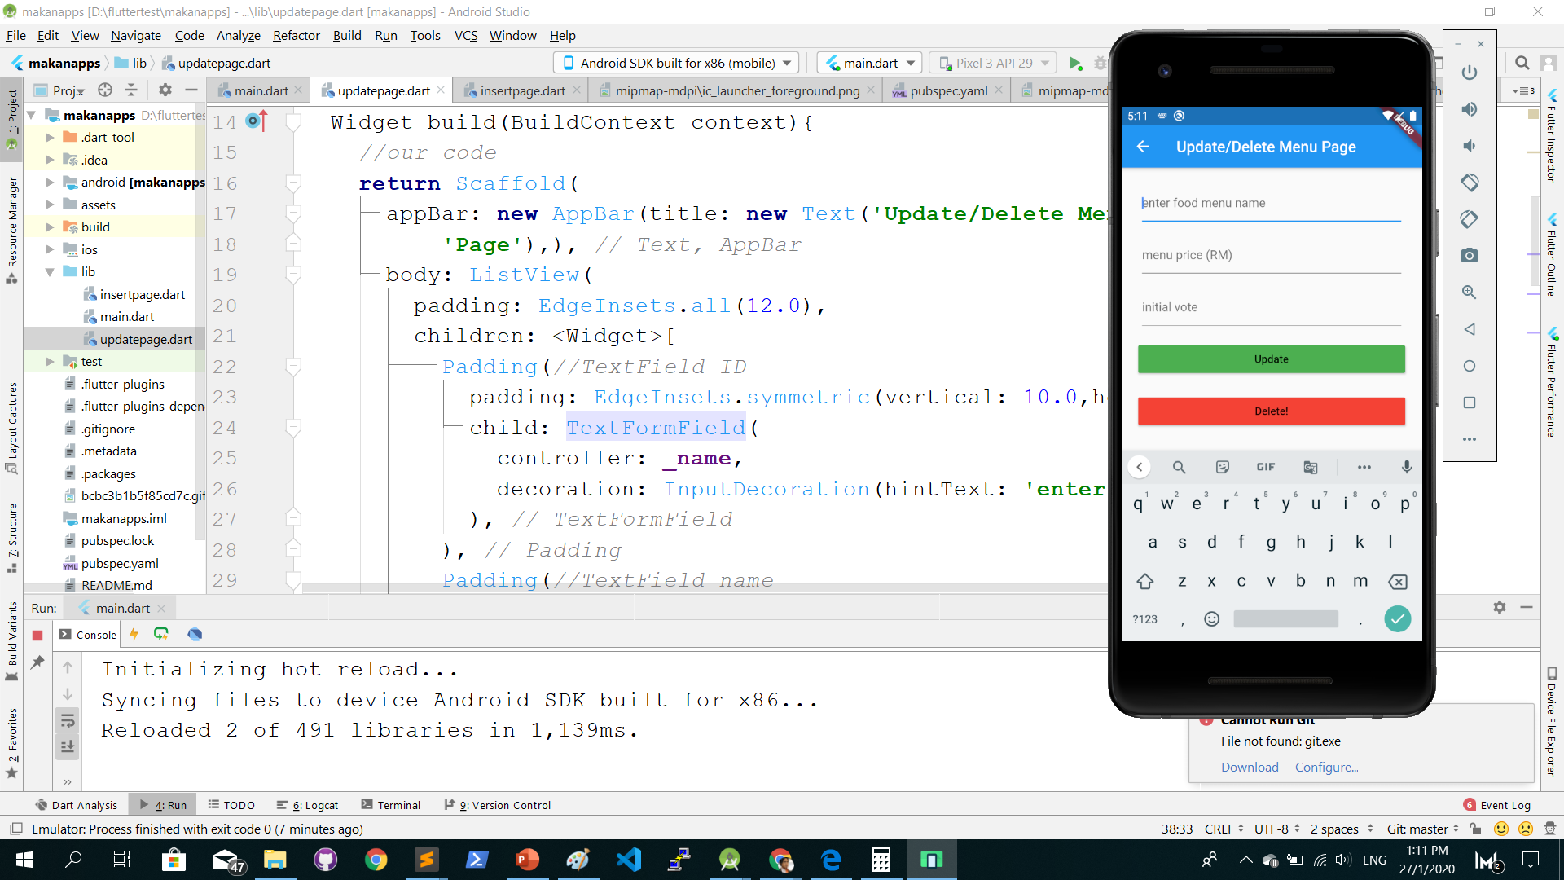
Update record using TextFormField

Slide 11
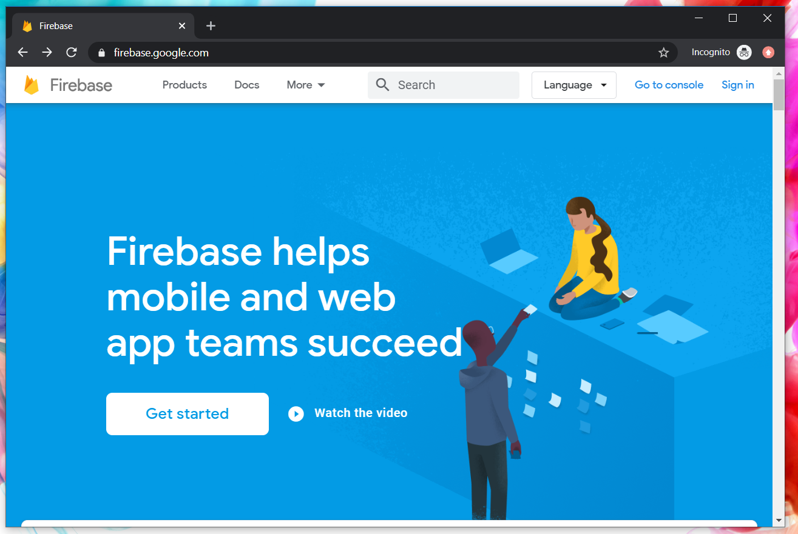
Google Firebase : Console
https://console.firebase.google.com/

Slide 12
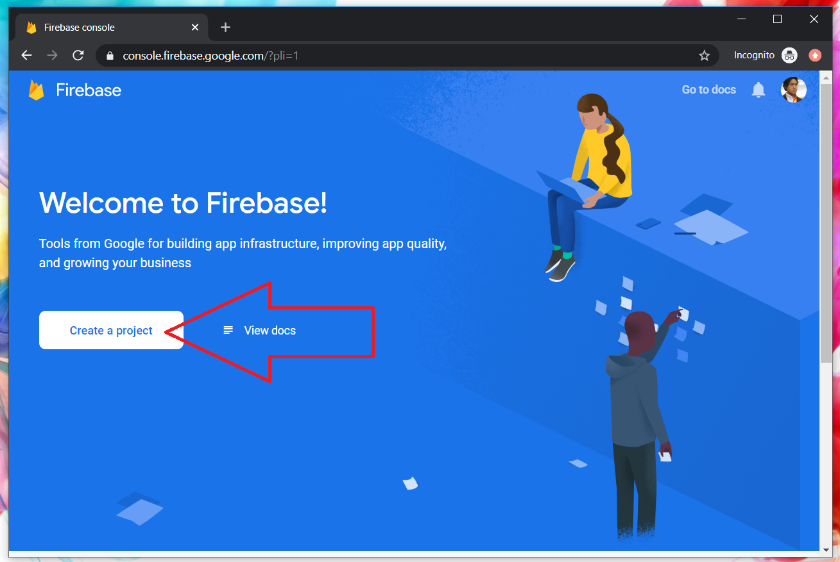
Google Firebase : Create new project

Slide 13
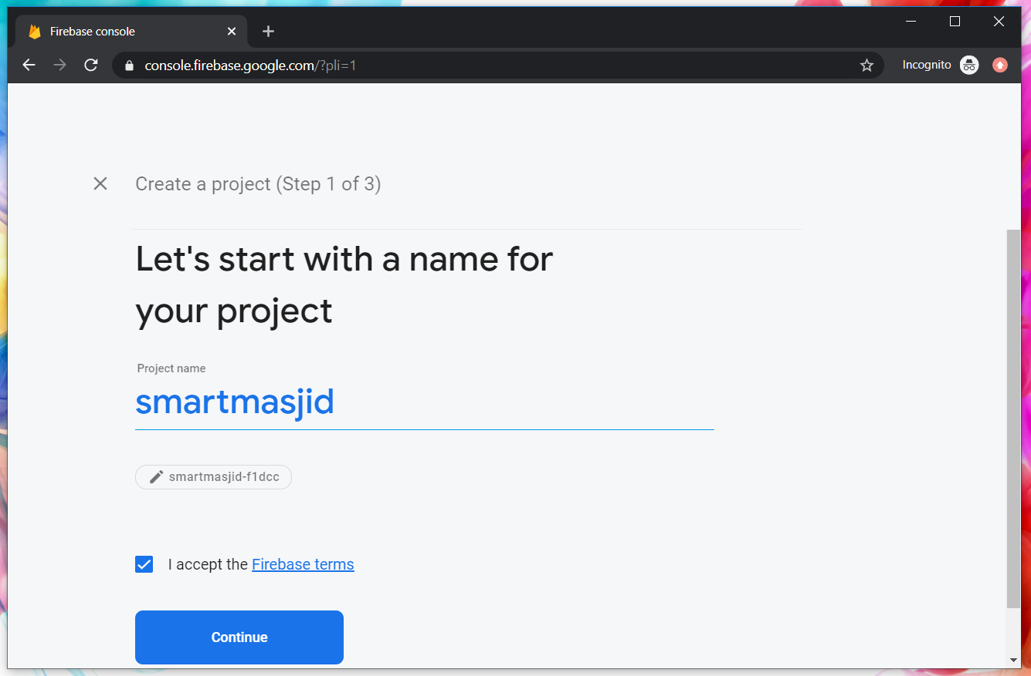
Google Firebase : Project name
makanapps

Slide 14
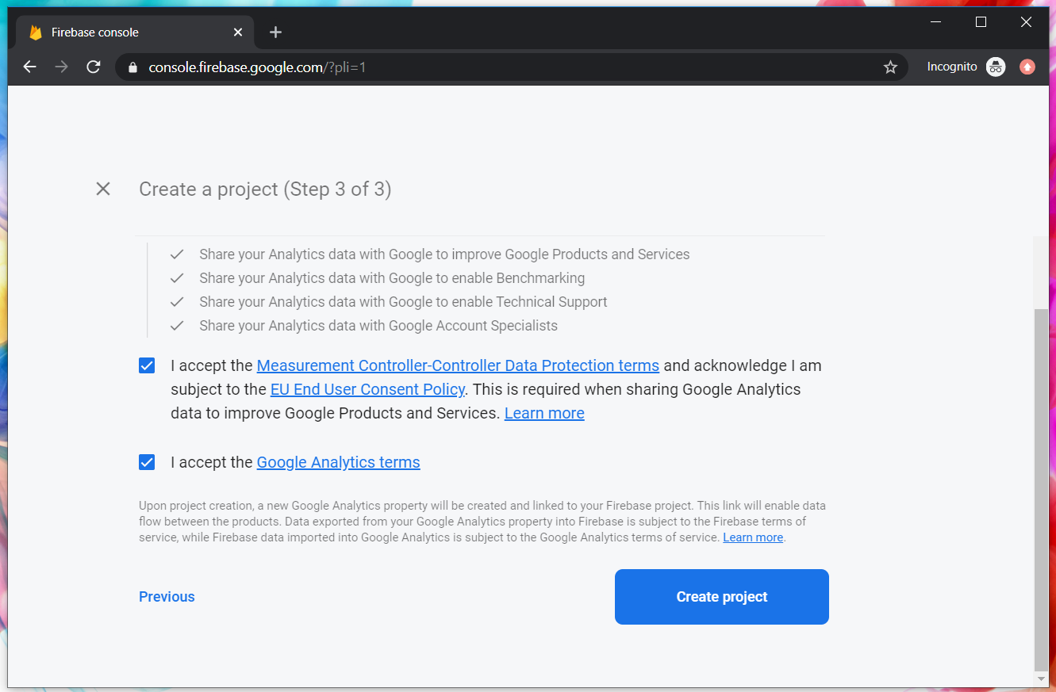
Google Firebase : Accept T&C

Slide 15
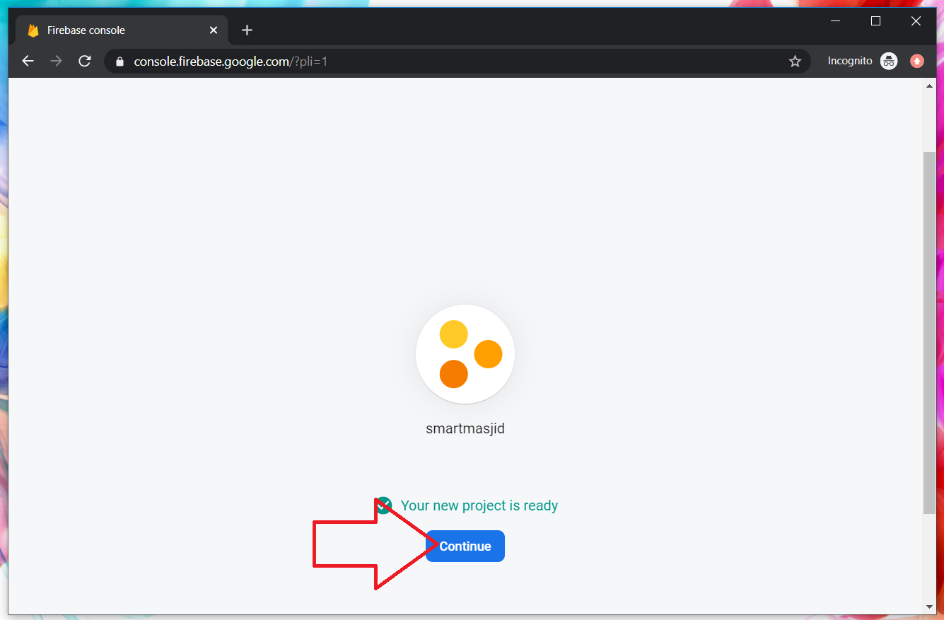
Google Firebase : Project ready and continue
makanapps

Slide 16
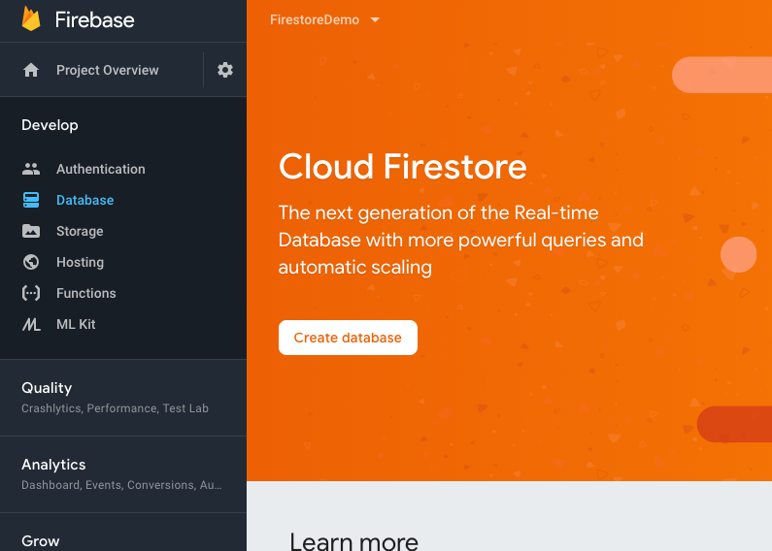
Google Firebase : Realtime database, automatic scaling

Slide 17
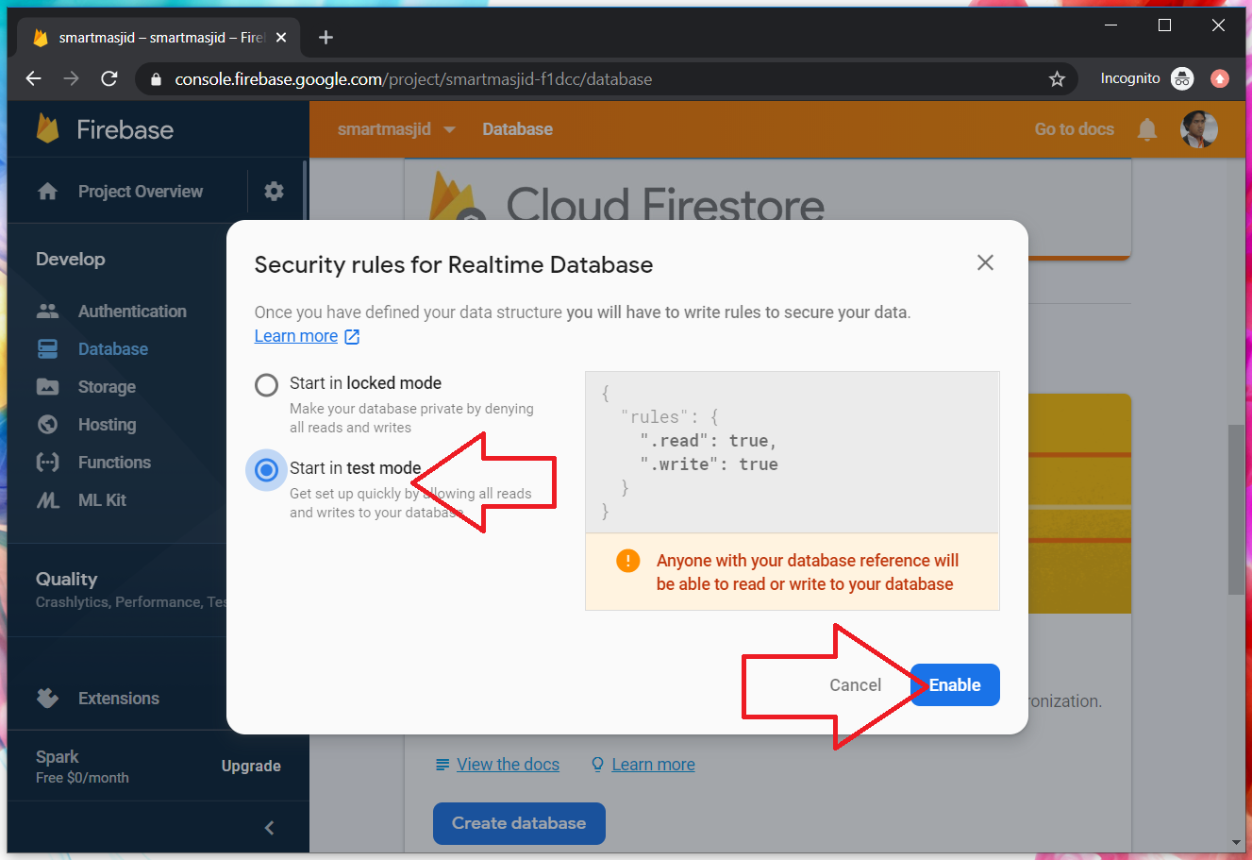
Google Firebase : Enable test mode

Slide 18
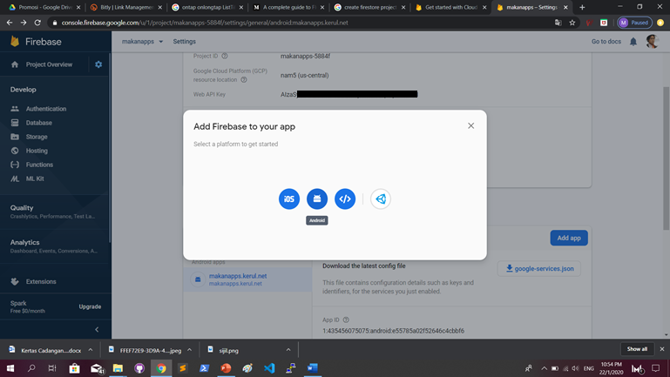
Google Firestore : add Firebase to app

Slide 19
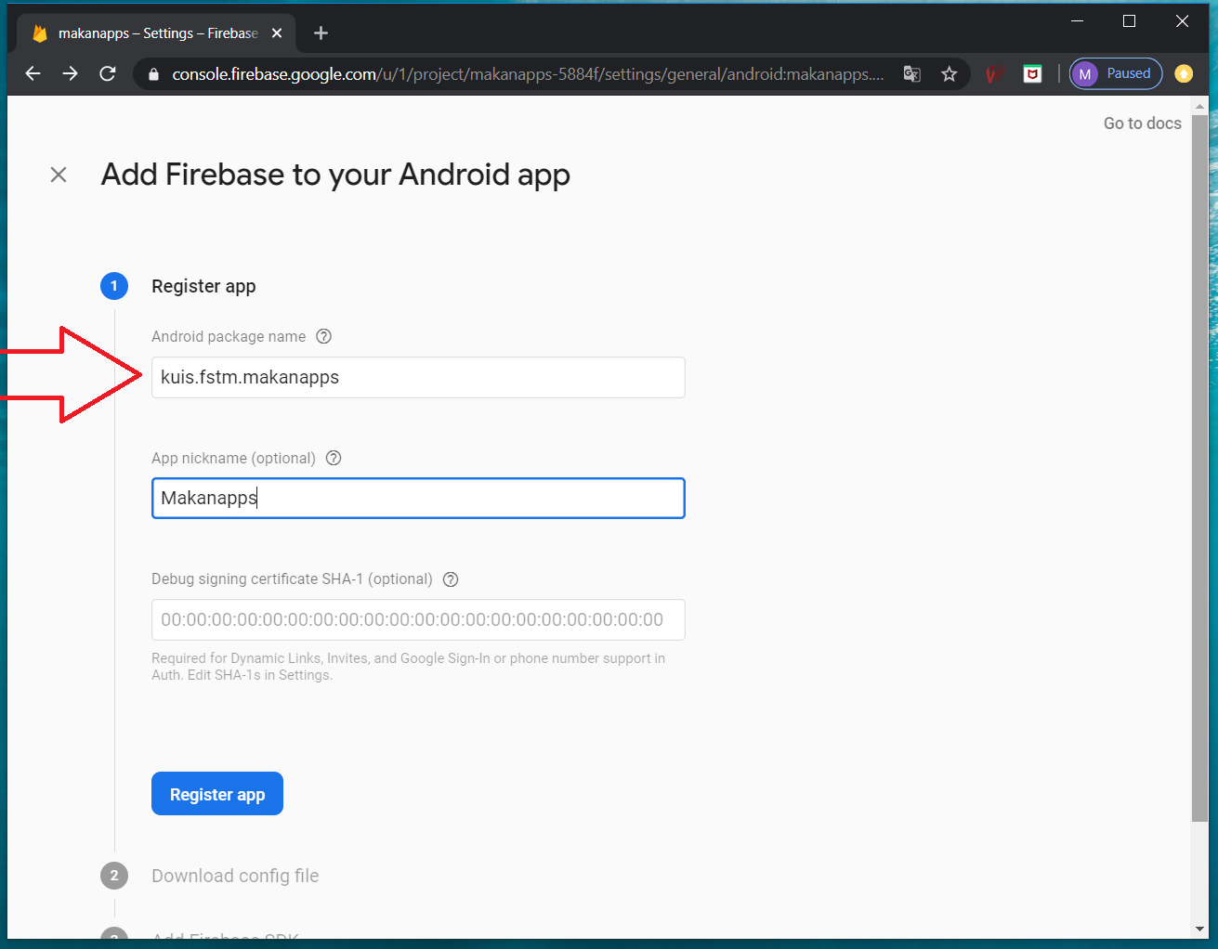
Google Firebase : Android package name & project nickname

Slide 20
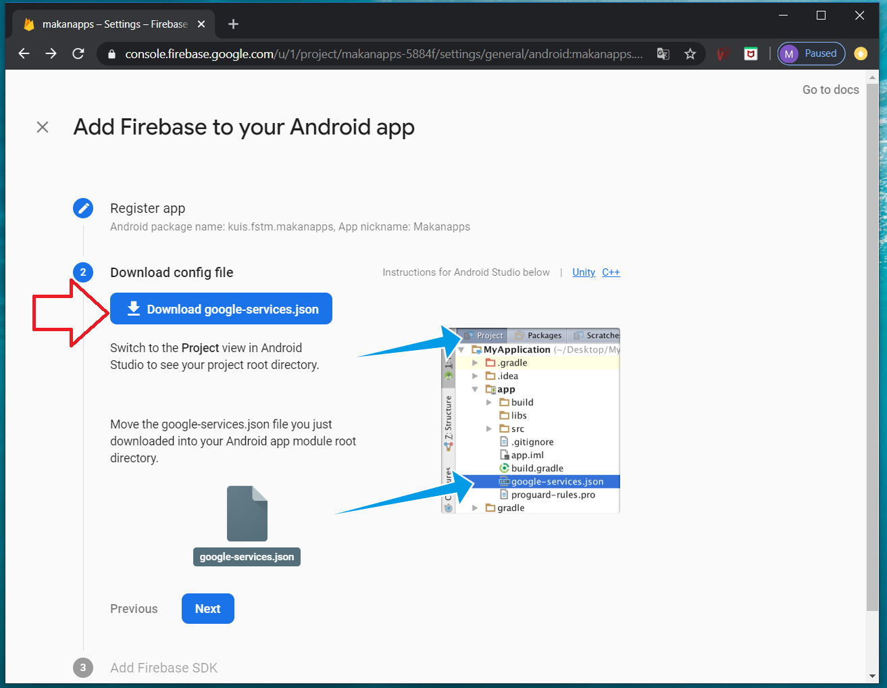
Google Firebase : download google-services.json

Slide 21
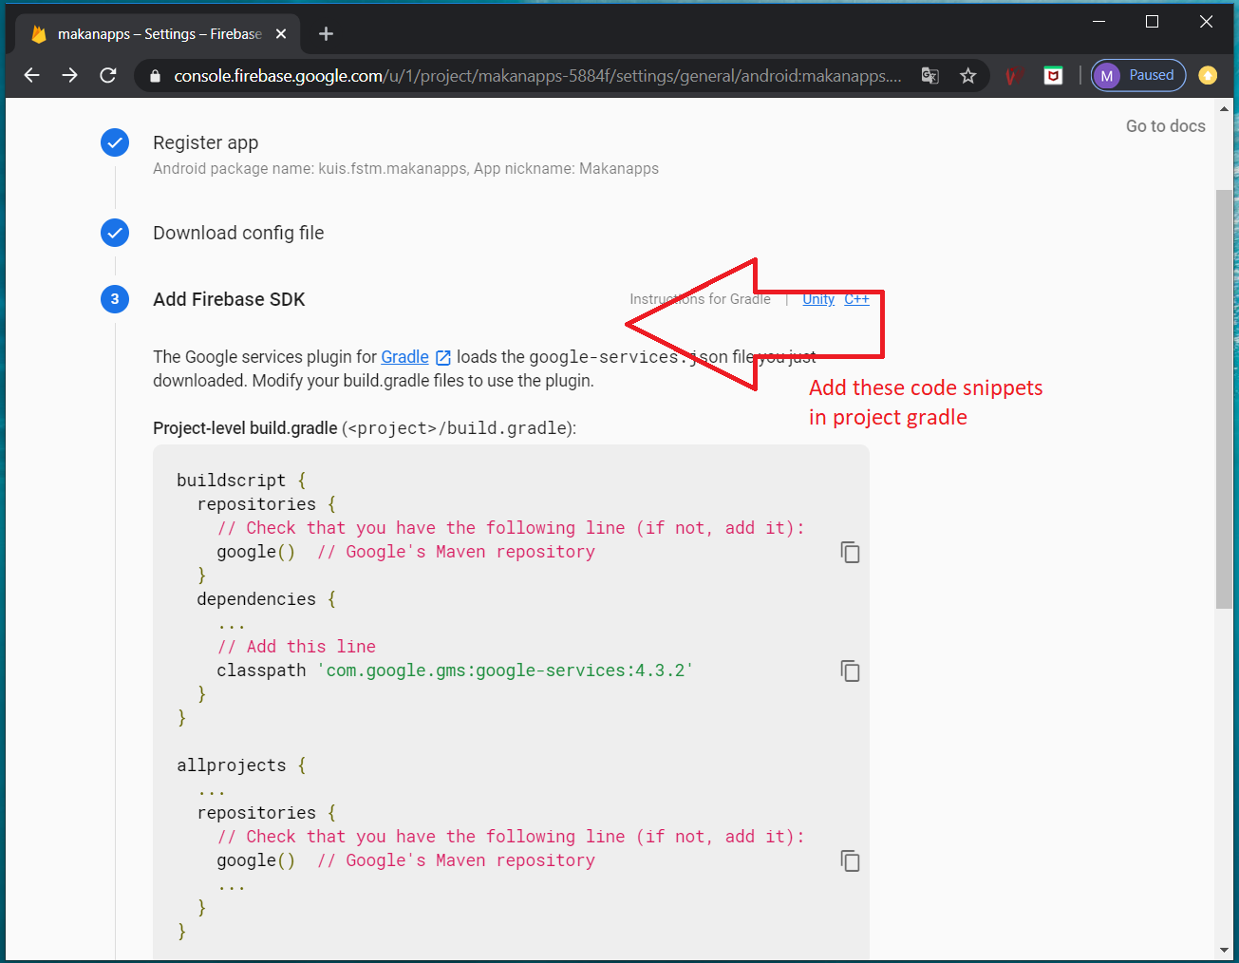
Google Firebase : add to project gradle

Slide 22
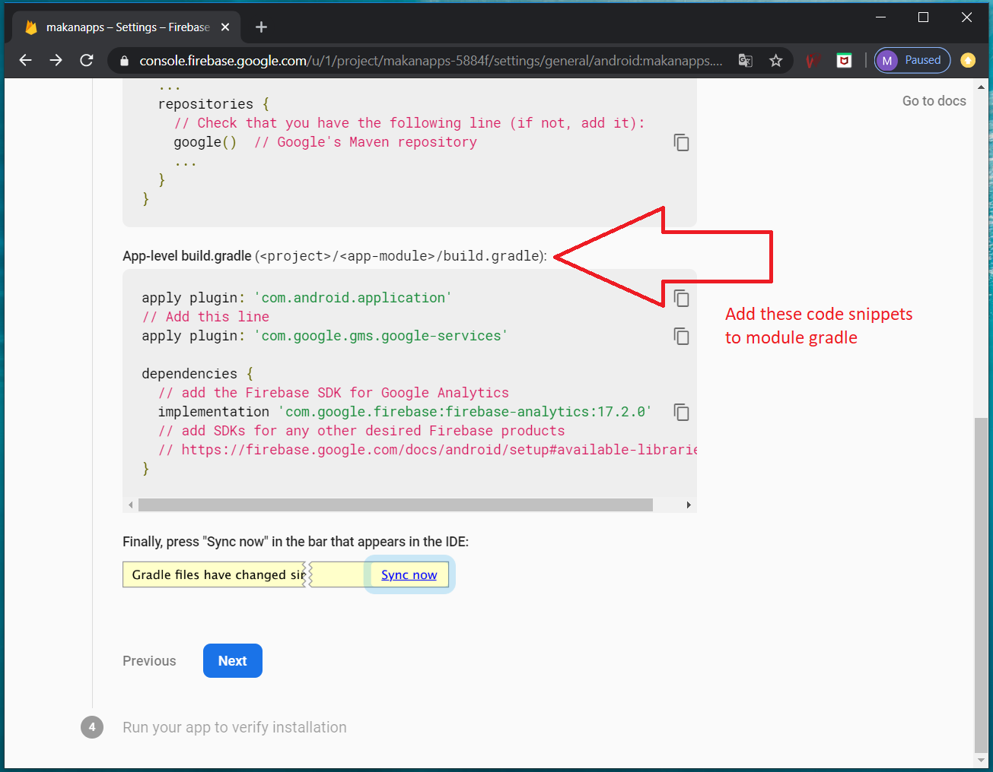
Google Firebase : add to module gradle

Slide 23
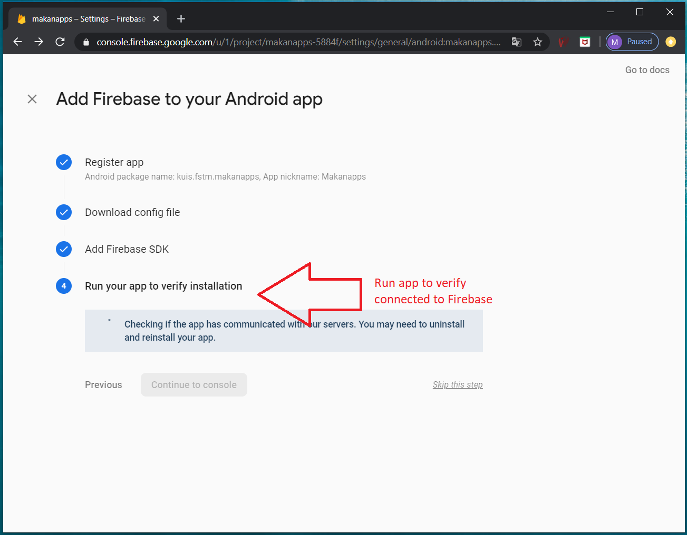
Google Firebase : run app to verify database connection

Slide 24
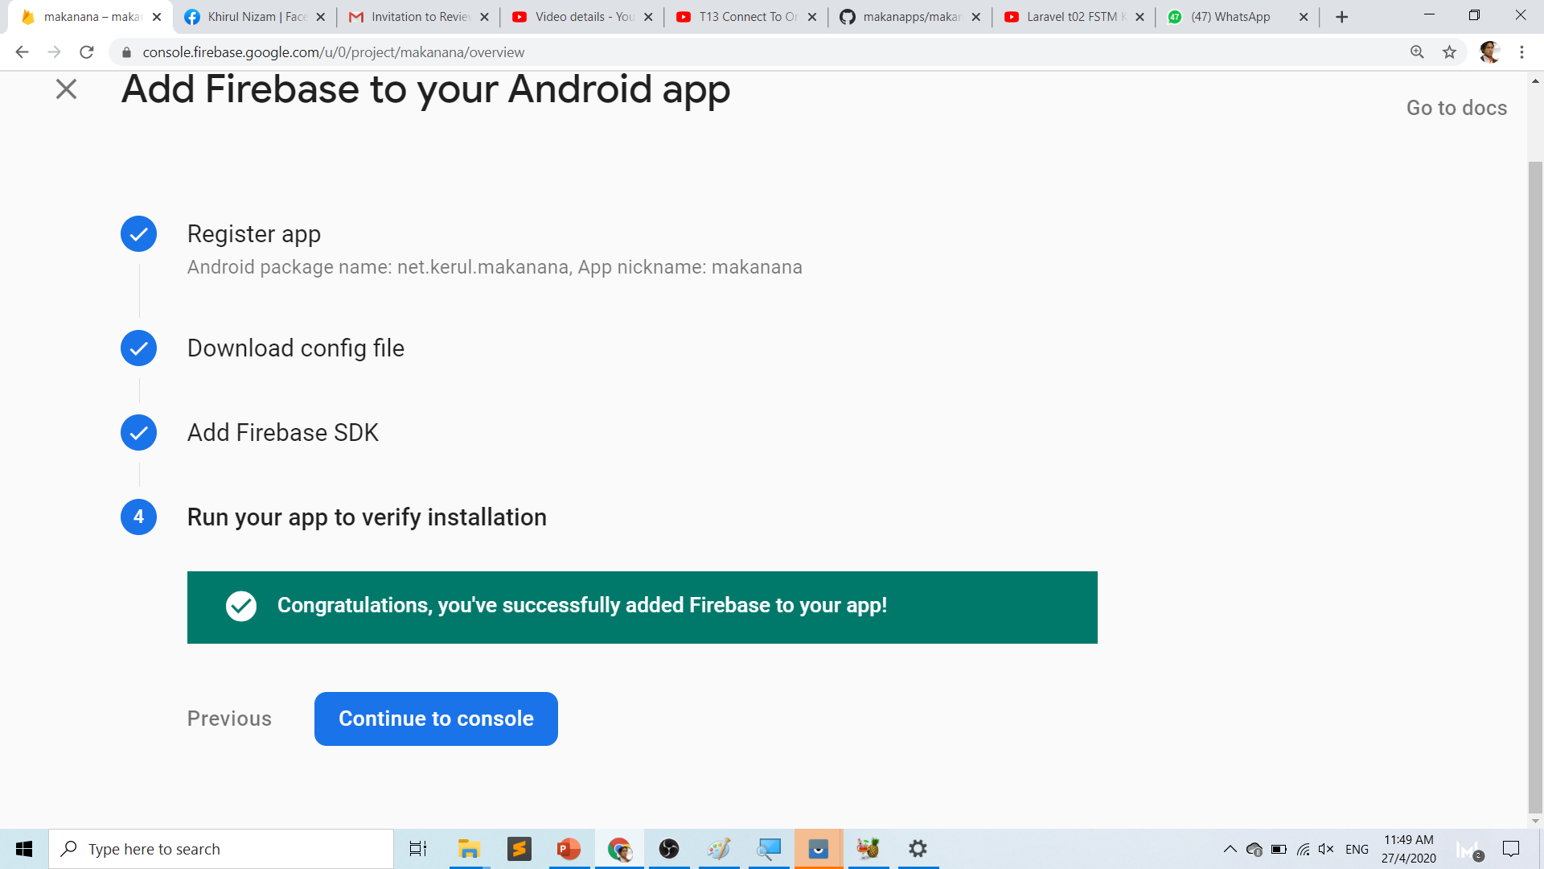

Slide 25
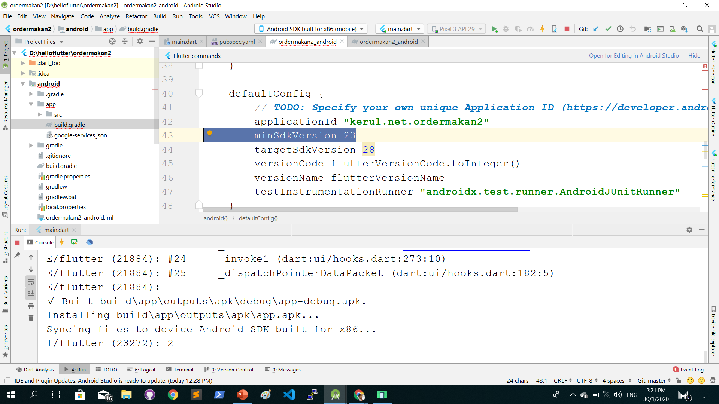
App build.gradle change minSdkVersion to 23

Slide 26
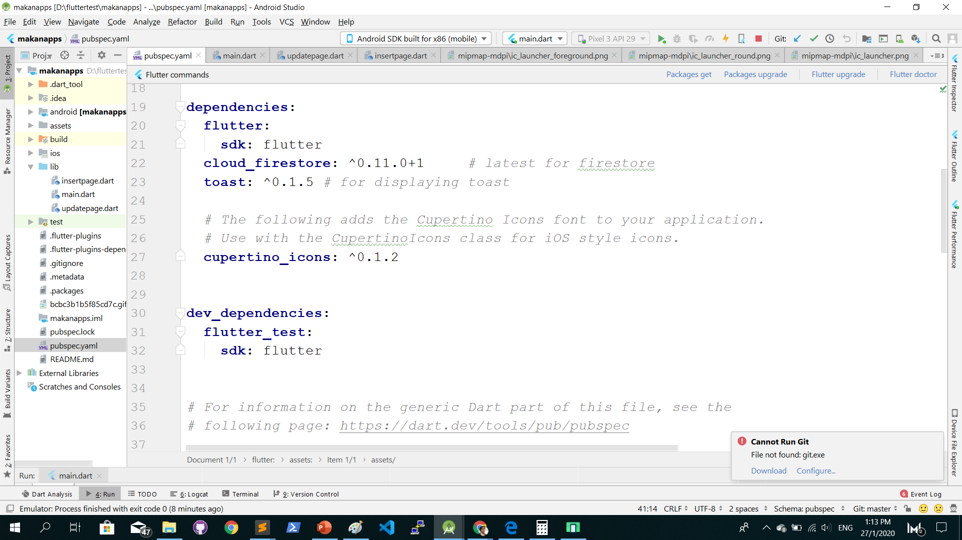
Add Firestore dependency in pubspec.yaml

Slide 27
Flutter – Firestore setup
Flutter setup to Firestore official docs
https://firebase.google.com/docs/flutter/setup

Slide 28
Push a new record from TextField

Slide 29
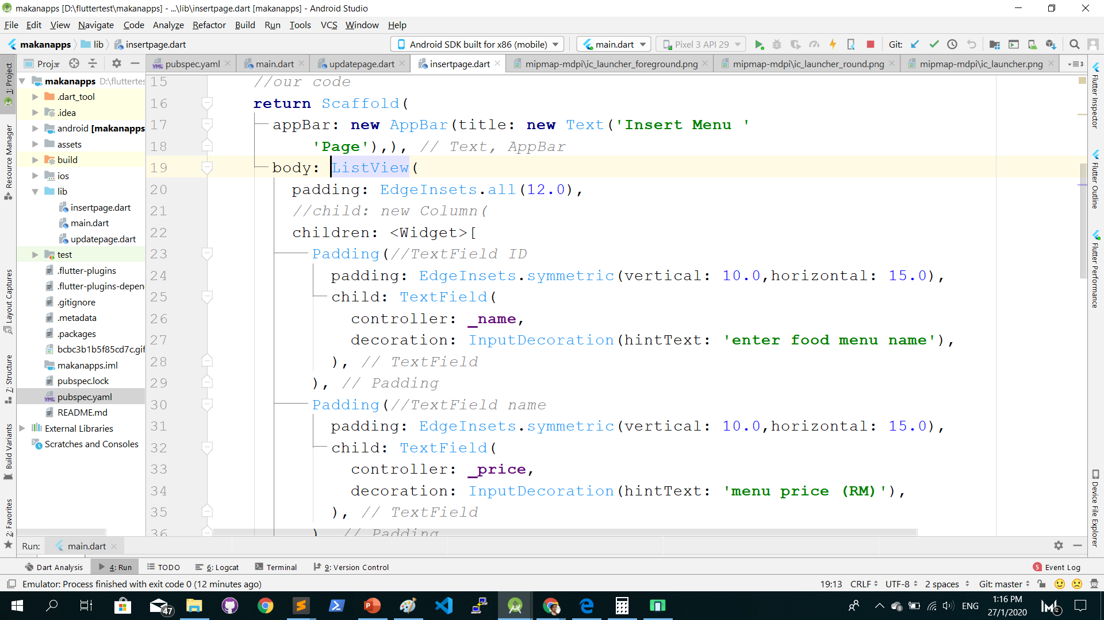
Create a new file insertpage.dart

Slide 30
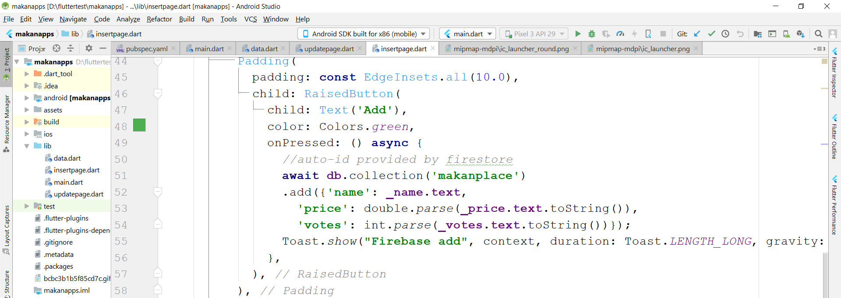
The insert record command to Firestore

Slide 31
Github.com/khirulnizam/makanapps wasap.my/60129034614
Youtube channel
bit.ly/kerulflutter

Slide 32
T14(a) Create Database/ Table Firestore (jadual/pangkalan data)
Youtube tutorials
bit.ly/kerulflutter

Slide 33
T14(b) Listing records (senaraikan rekod)
Youtube tutorials
bit.ly/kerulflutter

Slide 34
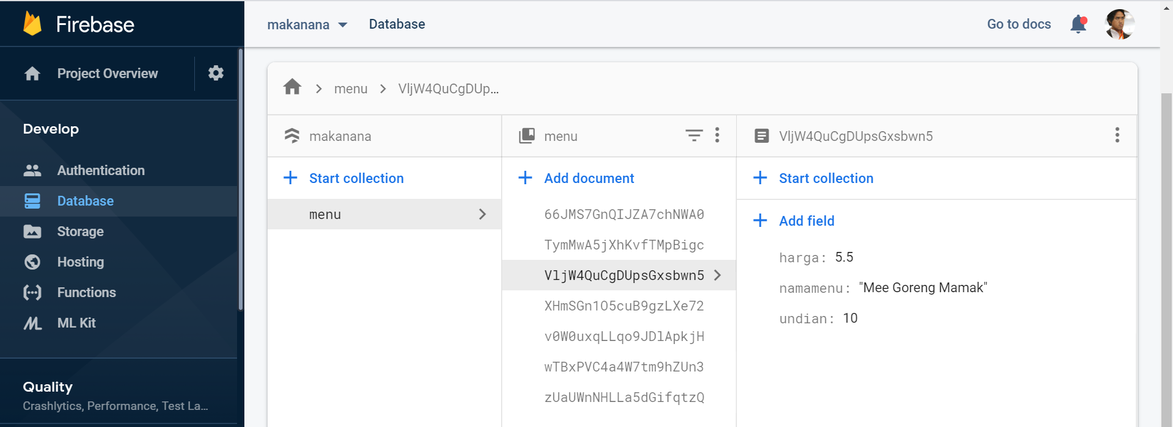
Records are ready in Firebase

Slide 35
Google Firebase : Console
https://console.firebase.google.com/

Slide 36
Flutter – Firestore setup
Flutter setup to Firestore official docs
https://firebase.google.com/docs/flutter/setup

Slide 37
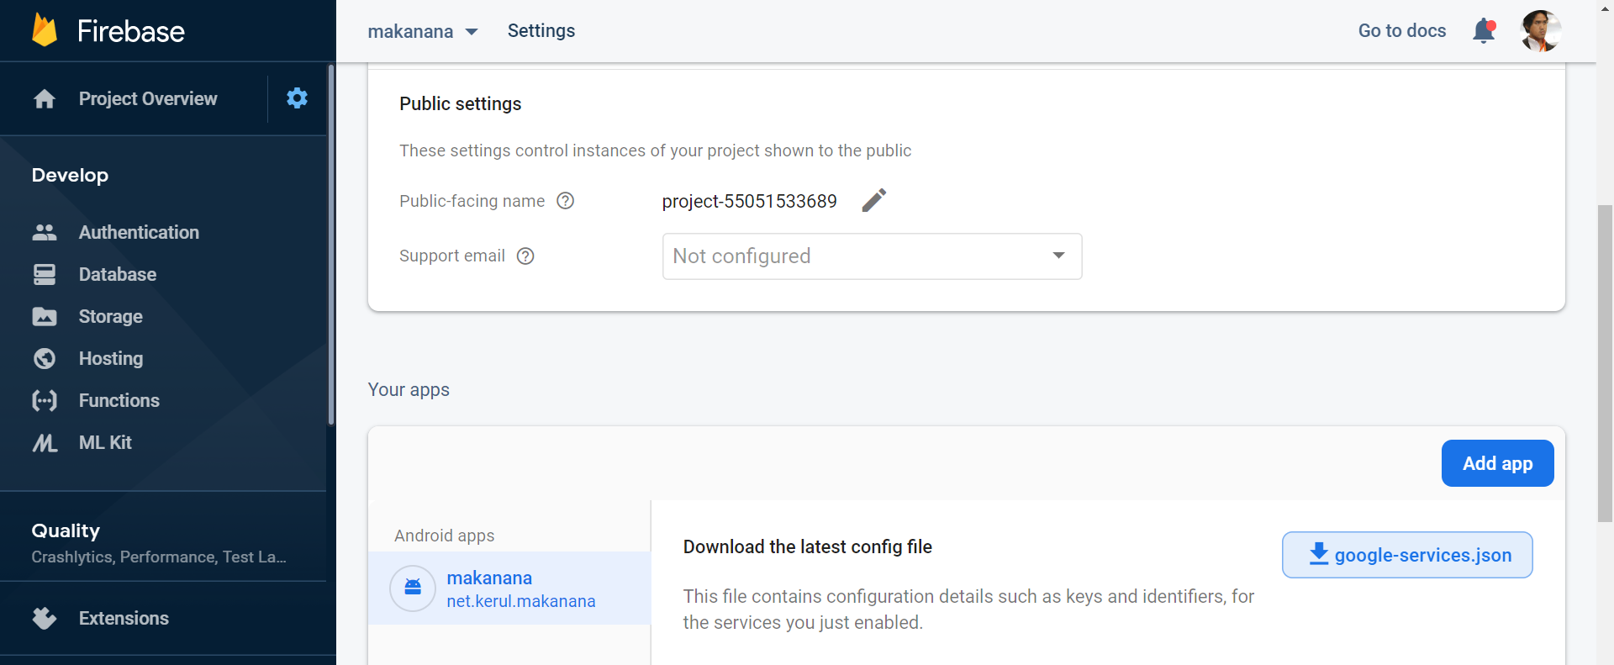
google.-services.json

Slide 38
Populate records to ListTile

Slide 39
Flutter – Firestore LAB
Flutter setup to Firestore official lab
https://codelabs.developers.google.com/codelabs/flutter-firebase/#4
Follow this LAB exercise

Slide 40
T15 Insert a new record (masukkan rekod baru)
Youtube tutorials
bit.ly/kerulflutter

Slide 41
Push a new record from TextField

Slide 42
GITHUB
github.com/khirulnizam/makanapps
Youtube tutorials
bit.ly/kerulflutter

Slide 43
T16 Update records (kemaskini rekod)
Youtube tutorials
bit.ly/kerulflutter

Slide 44
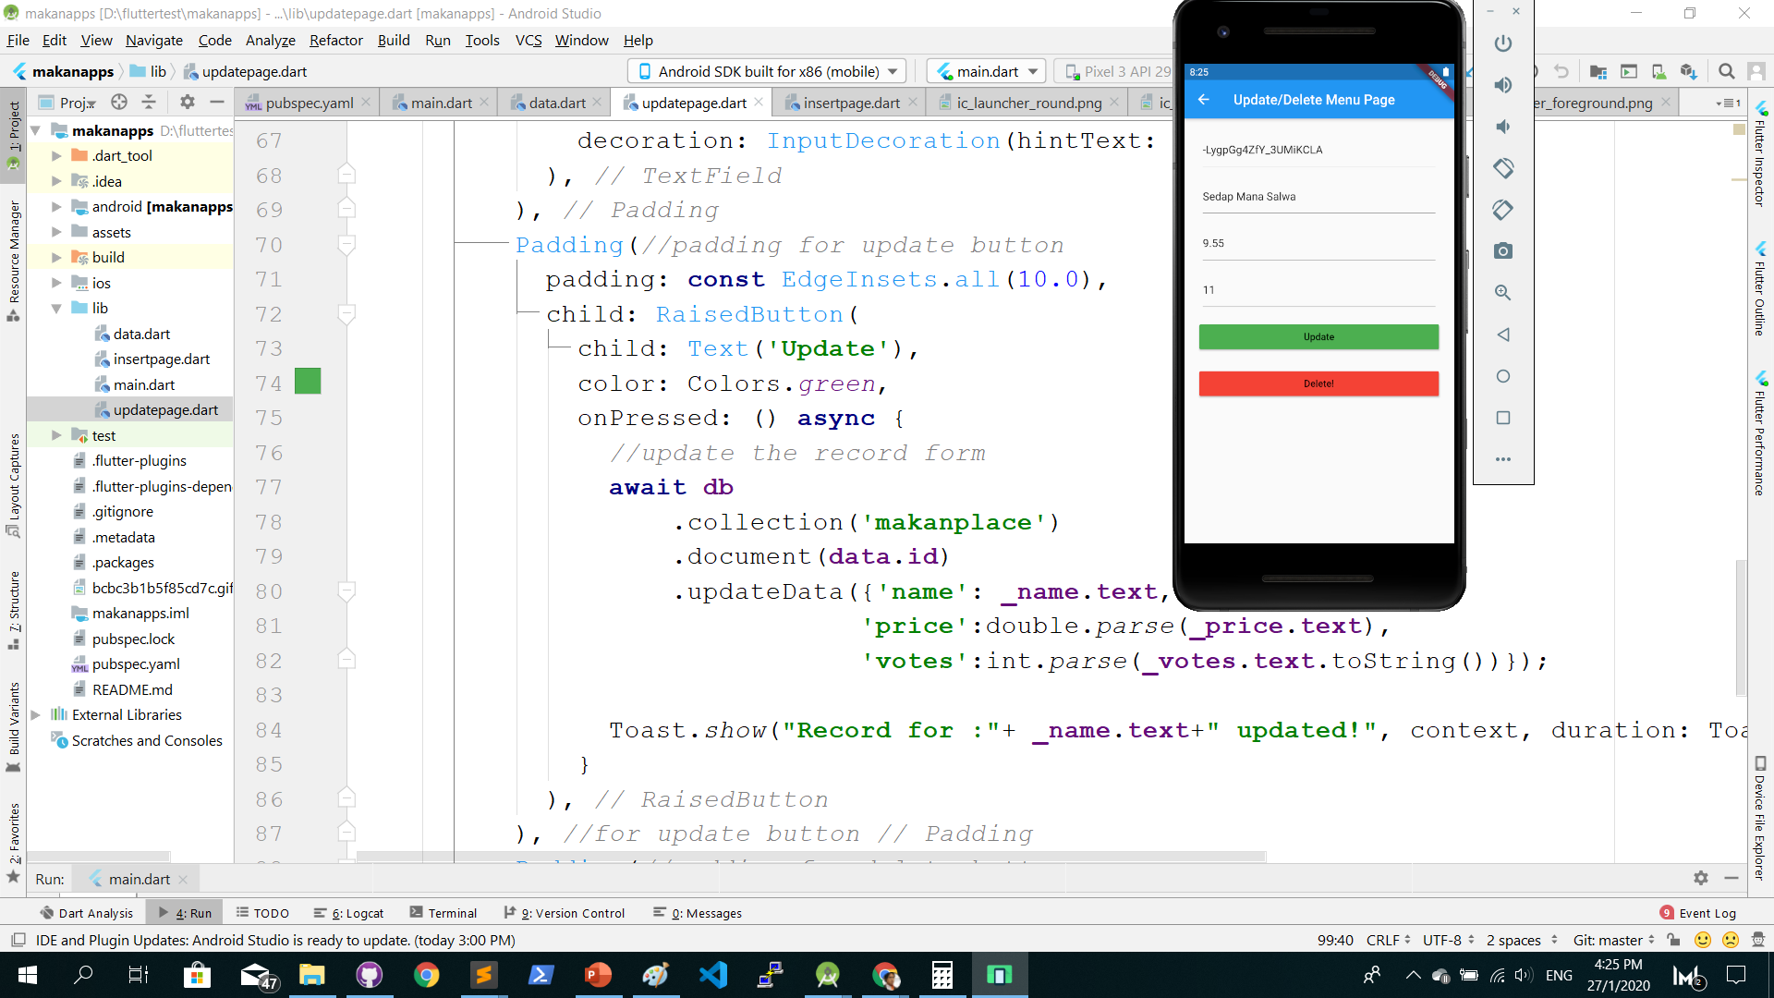
Update record using TextField

Slide 45

Update flow
id
namamenu
harga
undian

Slide 46
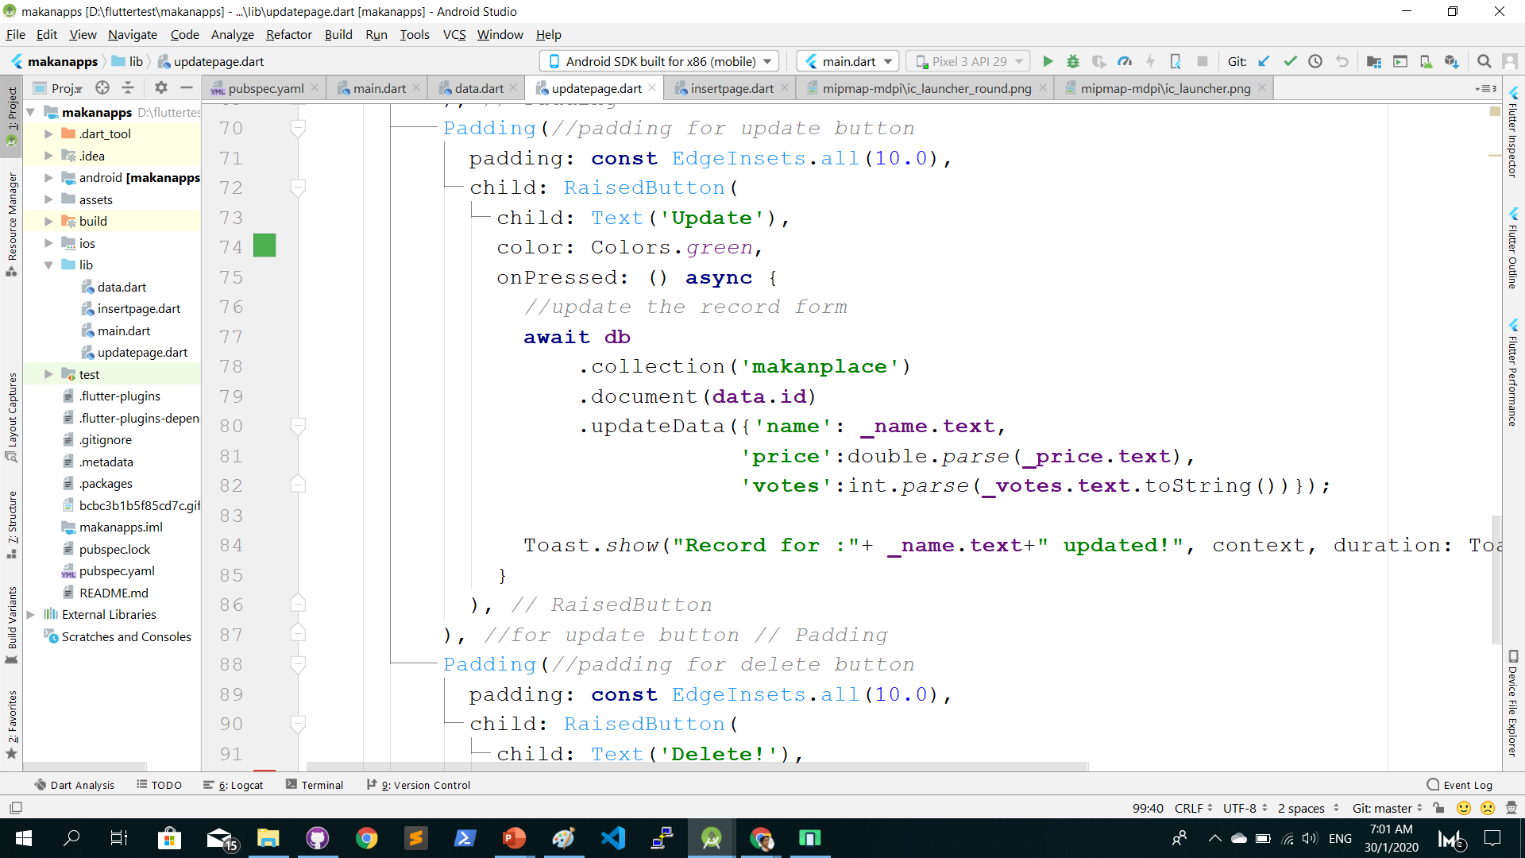
Create a new file updatepage.dart

Slide 47
Github.com/khirulnizam/makanapps wasap.my/60129034614
Youtube channel
bit.ly/kerulflutter

Slide 48
T17 Delete records (padam rekod)
Youtube tutorials
bit.ly/kerulflutter

Slide 49
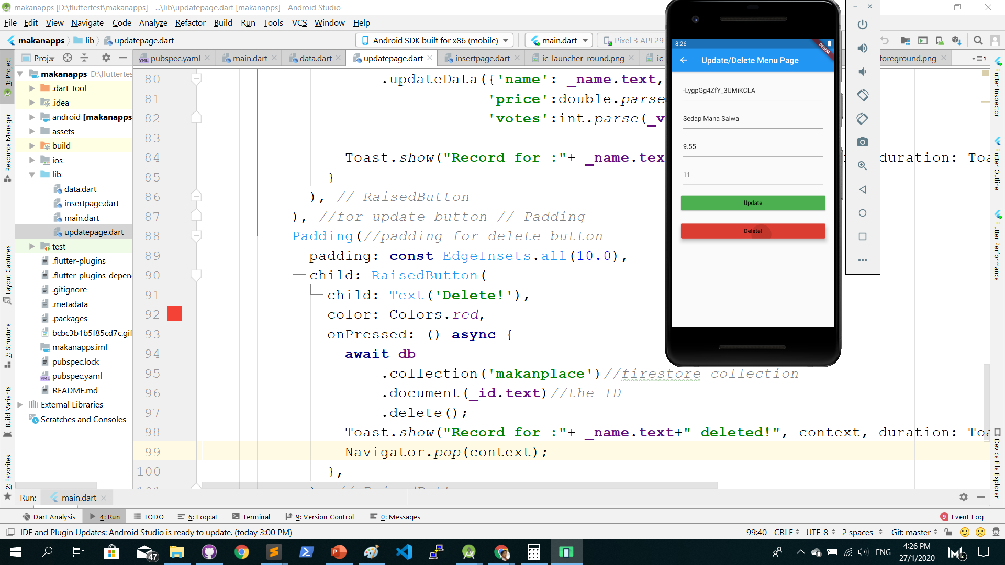
Delete record and return to main( )

Slide 50
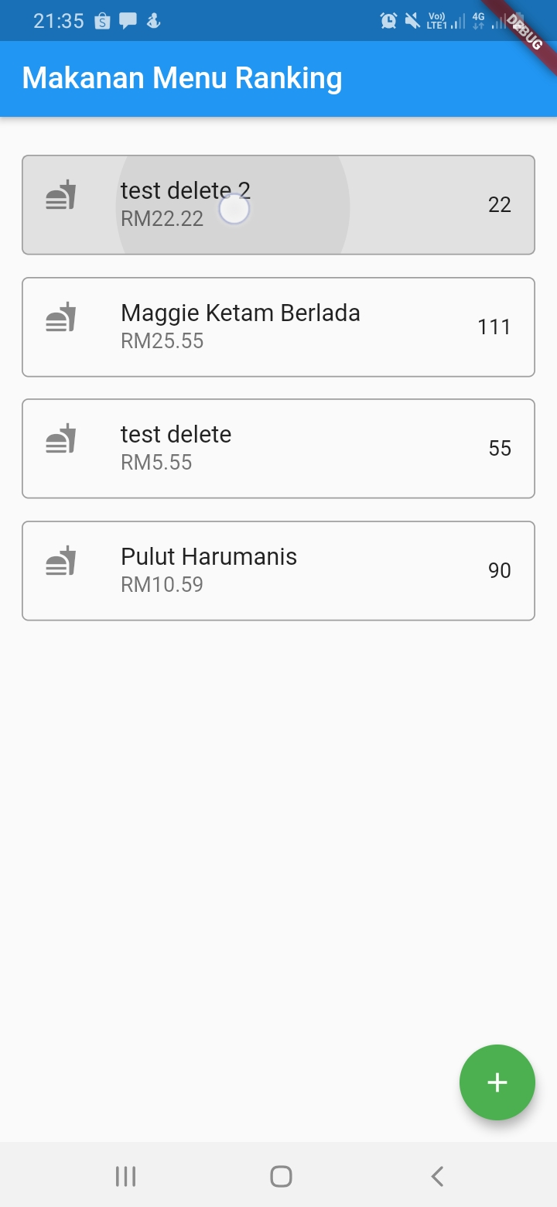
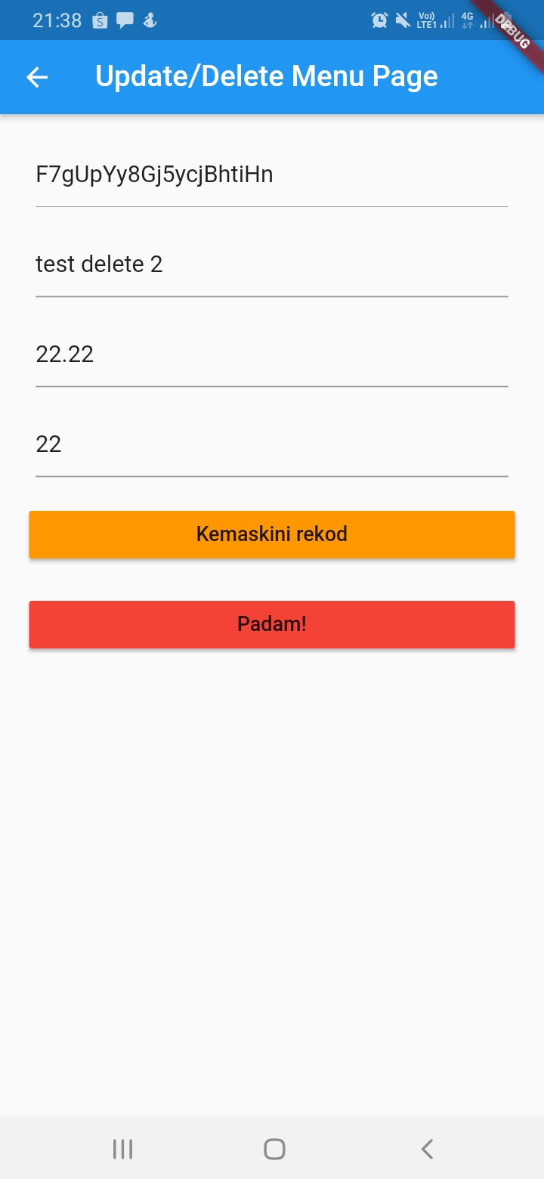
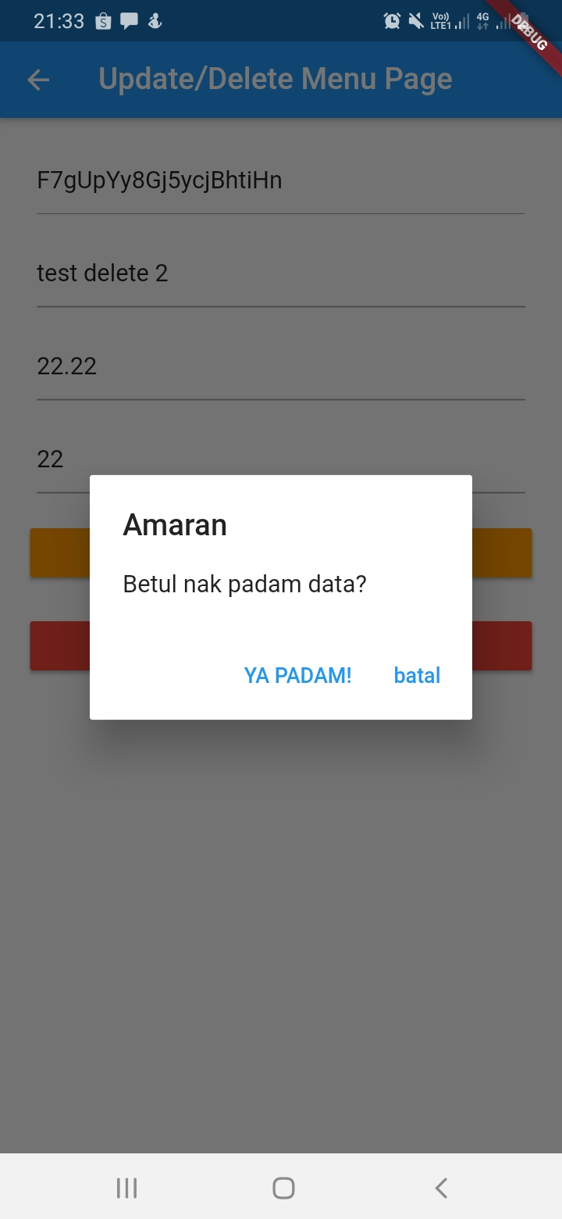
Delete flow

Slide 51
Github.com/khirulnizam/makanapps wasap.my/60129034614
Youtube channel
bit.ly/kerulflutter

Slide 52

T18 Authentication Firebase (pengesahan)
Youtube tutorials
bit.ly/kerulflutter

Slide 53
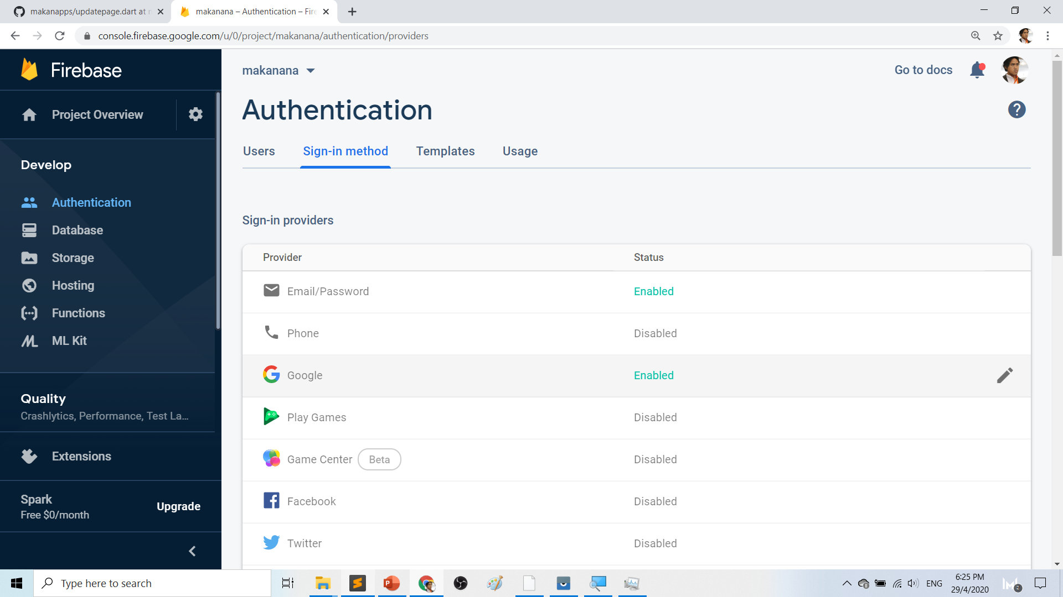

Slide 54
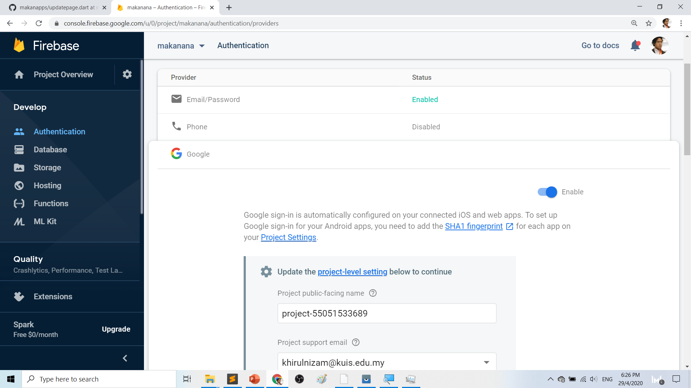

Slide 55
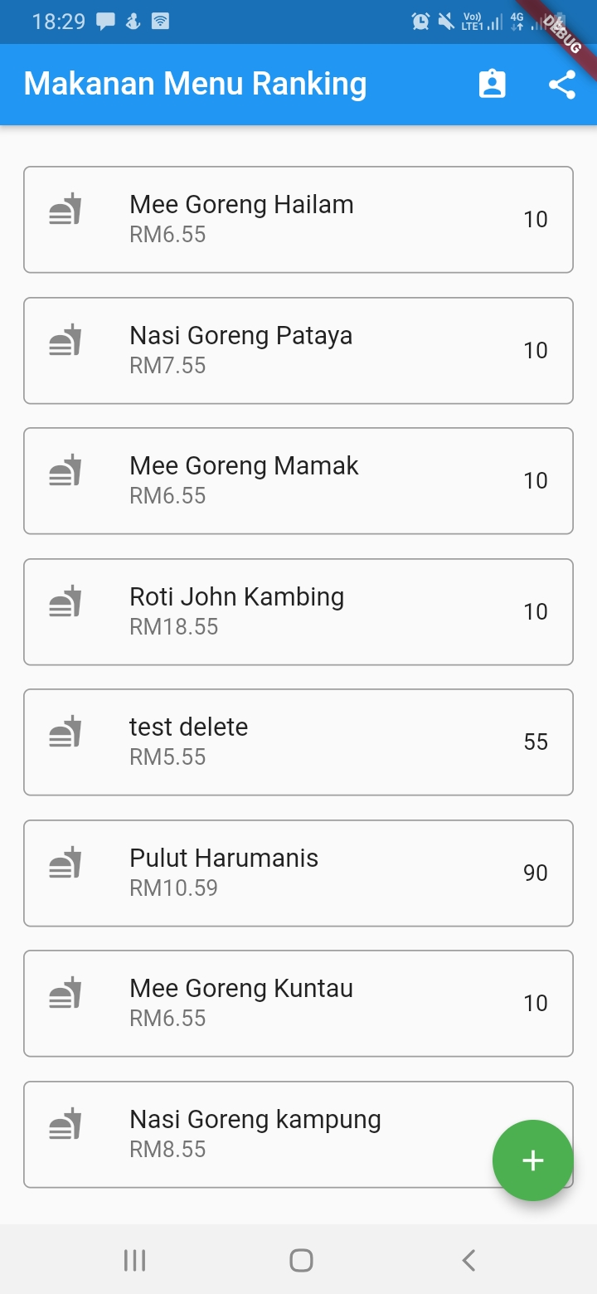
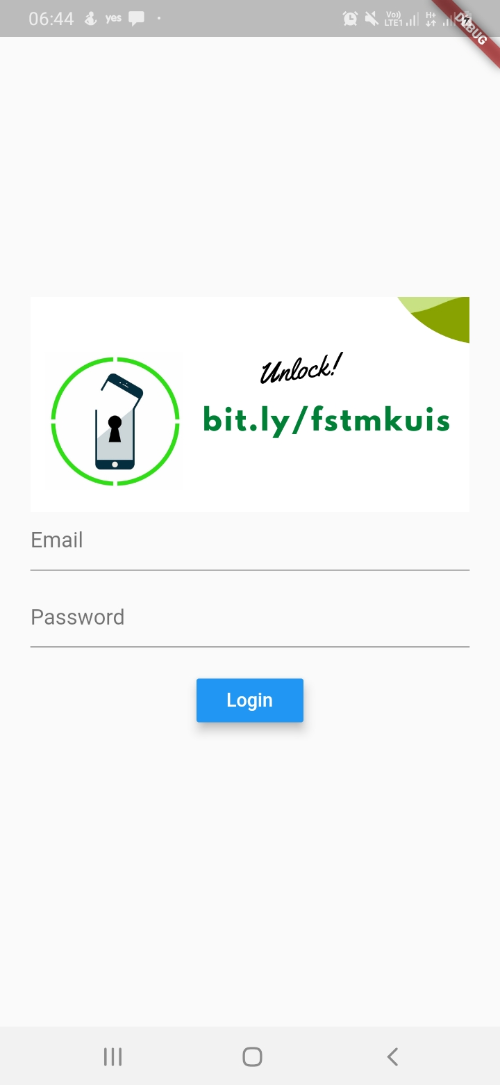
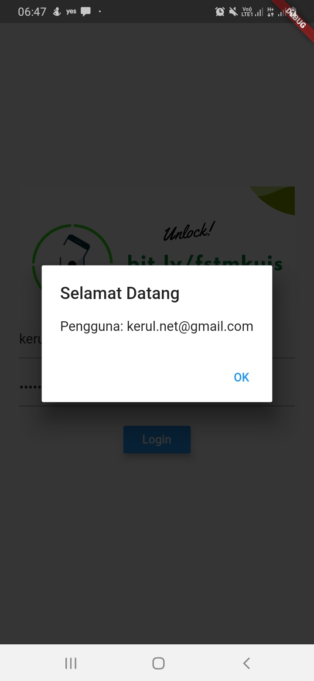
Login flow

Slide 56
Github (codes & slides)
Github.com/khirulnizam/makanapps wasap.my/60129034614
Youtube channel
bit.ly/kerulflutter

Slide 57
Thanks from bit.ly/kerulflutter

